Slide 1
Serial Adders
Lecture_13a_Serial Adders_Mealy_Design
Reference: Chapter 8, section 8.5, page 477, Stephen Brown, ZvonkoVranesic, “Fundamentals of Digital Logic with VerilogDesign”, Tata McGraw Hill Publishing Company Limited, Second Edition

Slide 2
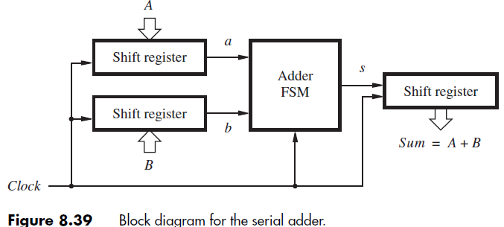
Serial Adders
Circuits which adds bits in a pair synchronously with clock

Slide 3
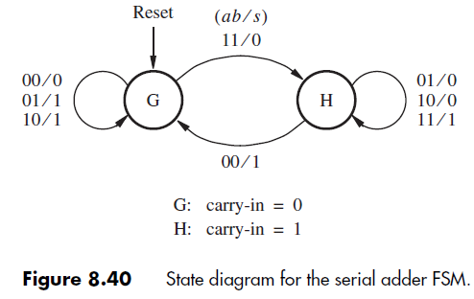

Slide 4
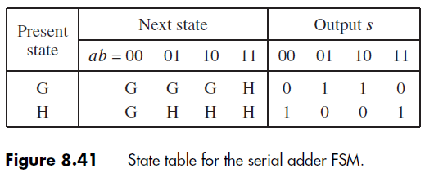

Slide 5
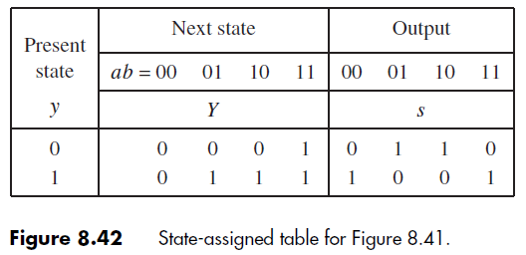

Slide 6
